Slide 1
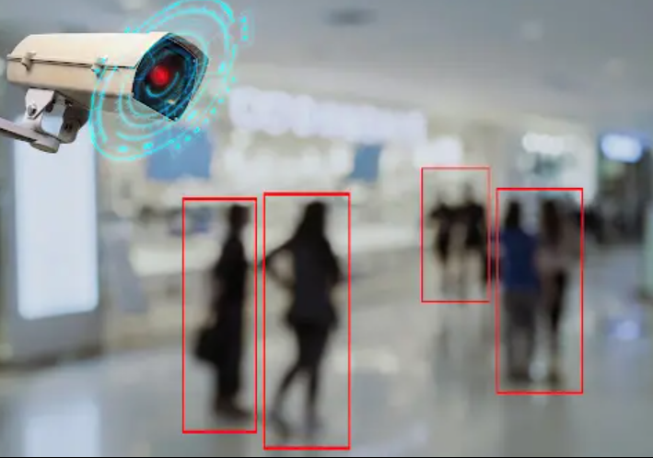
AI Smart Weapon Detection
By:
Saad Amir (Fa-21/BSCS/051)
Nawab Iftikhar (Fa-21/BSCS/076)
Supervised By:
Ma’am Anila Amjad

Slide 2

Agenda:
Abstract
Introduction
Problem Statement
Project Scope
Methodology
Desktop Application UI design
Tools and Languages
Conclusion
References

Slide 3
Abstract
Security and surveillance systems play a critical role in ensuring public safety and safeguard assets around the word, but these systems are often challenged by the overwhelming amount of data which they have to monitor and analyze.
The program is comprised of advanced technologies including artificial intelligence (AI), machine learning (ML), computer vision, data mining, digital image processing, feature engineering to analyze patterns, detect anomalies and anticipate potential threats. By integrating these technologies, the system can process vast amount of data from various sources such as camera, sensors to report any unusual activity taking place at that moment of time.

Slide 4
Introduction
In today’s modern world, safety and security is a big concern, cameras to some extent assist in this regard but that requires a person who monitors it almost all the time.
What if we don’t have to do any hustle just one time installation and we would get all the potential threat warnings on our smart devices or sent directly to security department depending on you, with rising crime rates there must be a solution to this problem and that’s where this project helps, it does this by analyzing people behavior in proposed places where security is of key importance and if they do anything suspicious or are in danger or in need of help the program informs the appropriate authorities.

Slide 5

Problem Statement
Increased Crime Rates
Surveillance Issues
More security guards needed
Prevents oversight in manual surveillance
Shoplifting
Robberies

Slide 6
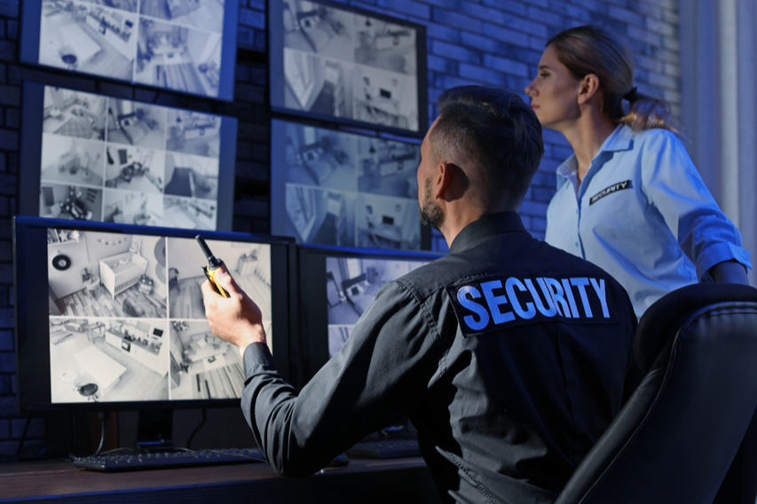
Problem Statement
A lot of security personnel are required for surveillance and security. An ML model will help a lot in this regard.

Slide 7

Project Scope
This project will aid in reducing robberies
Accurate Detection
Recording system for enhanced surveillance
Alarm System
User friendly interface

Slide 8
Project Scope
Useful for:
Banks
Schools
Jewelery Stores
Grocery Stores
Secure Facilities i.e. government buildings

Slide 9
Methodology
The project is based on a plethora of concepts such as
Computer Vision
Machine Learning
Digital Image Processing
Web Scraping
Feature Engineering

Slide 10
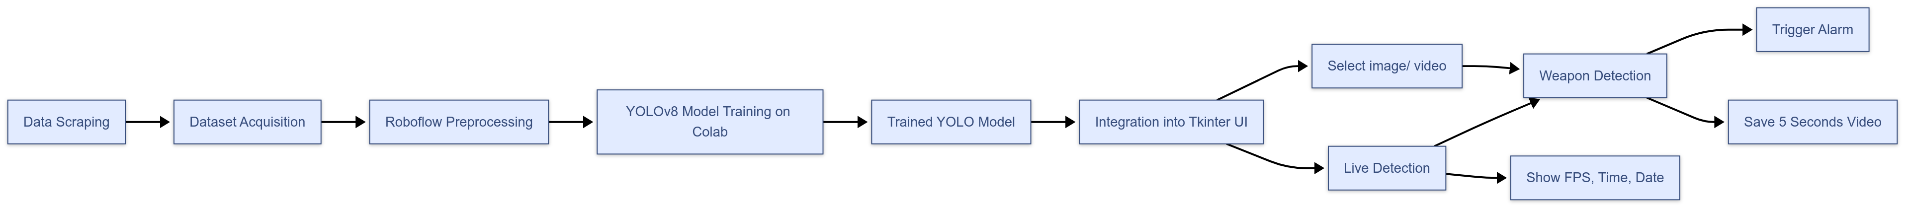
Methodology

Slide 11
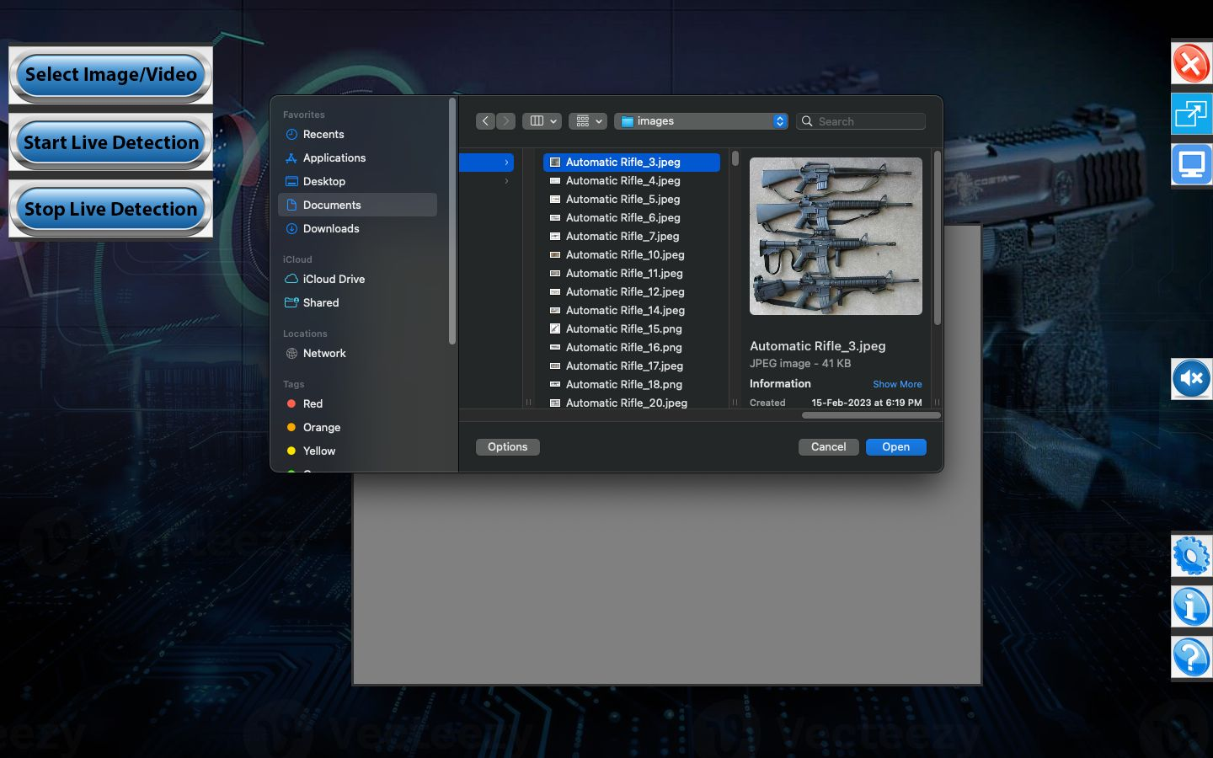
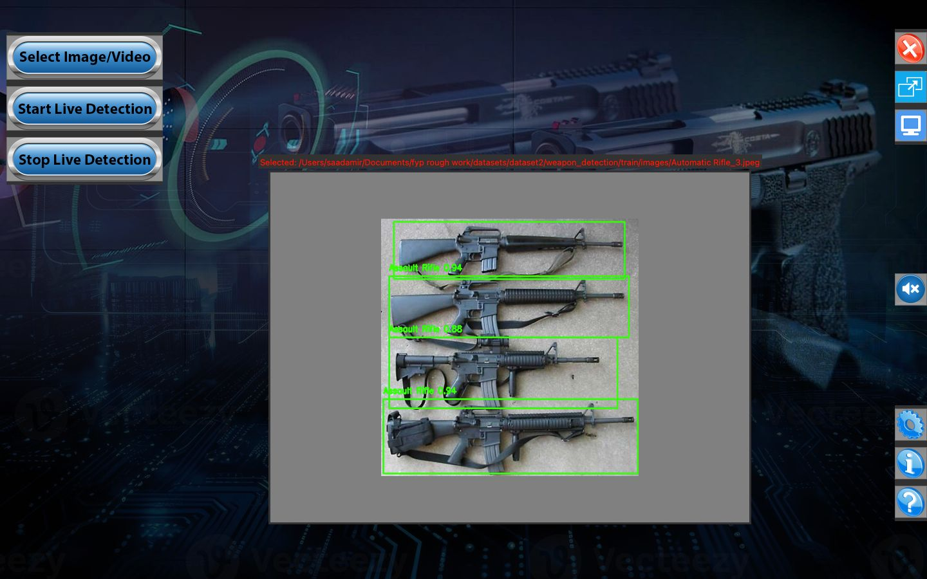
Desktop Application UI Design

Slide 12
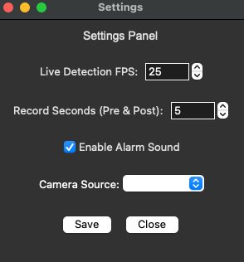
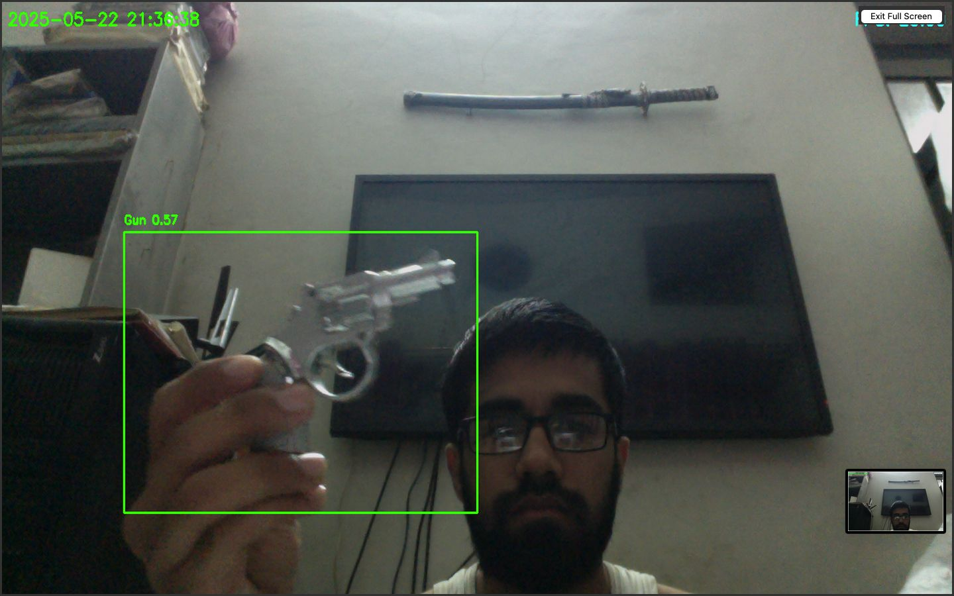
UI Design

Slide 13






Tools and Languages
Jupyter Notebook
Python
opencv
pytorch
roboflow
numpy
sklearn
selenium
beautifulsoup (BS4)
Scrapy

Slide 14
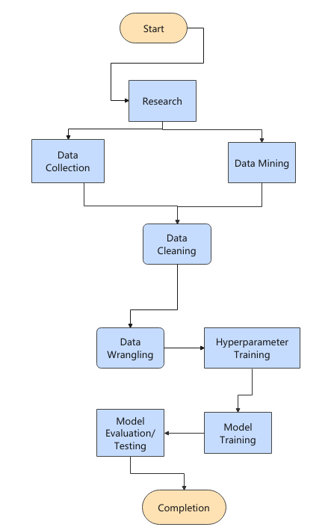
Flowchart Diagram:

Slide 15
Conclusion
The proposed weapon detection system successfully addresses the problem stated in the introduction providing an automated, efficient, and reliable tool to detect weapons in images, videos, and real-time streams. By integrating a YOLO-based deep learning model into a user-friendly desktop application, the system enables rapid identification of weapons and immediate response through alert generation and video recording.

Slide 16
References
Here is the list of publications that we take inspiration from:
This link is a reference, where importance of computer vision is discussed, furthermore by reading this article we gained insight on existing models and decided to create a model that will help with security:
“https://viso.ai/applications/computer-vision-in-smart-city-applications/”
Another reference link that emphasizes the importance of a surveillance system: “https://viso.ai/applications/computer-vision-applications-in-surveillance-and-security/
Here is another article that talks about stealing and robbery detection: “https://medium.com/analytics-vidhya/theft-detection-using-machine-learning-a4232ea51f1c/”

